Slide 1
Minimum Spanning Tree
Algorithms & Data Structures
ITCS 6114/8114
Dr. Dewan Tanvir Ahmed
Department of Computer Science
University of North Carolina at Charlotte

Slide 2
Minimum Spanning Trees
2704
867
BOS
849
PVD
ORD
740
187
144
1846
621
JFK
802
184
1258
SFO
1391
BWI
337
1464
1090
LAX
1235
DFW
946
1121
MIA
2342

Slide 3
Outline and Reading
Minimum Spanning Trees
Definitions and crucial fact
Prim’s Algorithm or Prim-Jarnik Algorithm
Kruskal's Algorithm
Key ref:
Introduction to Algorithms. Thomas H. Cormen, Charles E. Leiserson, Ronald L. Rivest, Clifford Stein.

Slide 4
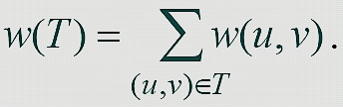
Minimum Spanning Tree
Problem: given a connected, undirected, weighted graph, find a spanning tree using edges that minimize the total weight:
6
4
5
9
14
2
10
15
3
8

Slide 5
Minimum Spanning Tree
Which edges form the minimum spanning tree (MST) of the below graph?
See next slide for answer
A
6
4
H
5
B
9
C
14
2
10
G
E
15
D
3
8
F

Slide 6
Minimum Spanning Tree
Answer:
A
6
4
H
5
B
9
C
14
2
10
G
E
15
D
3
8
F

Slide 7
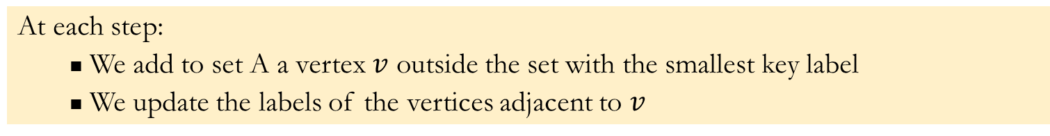
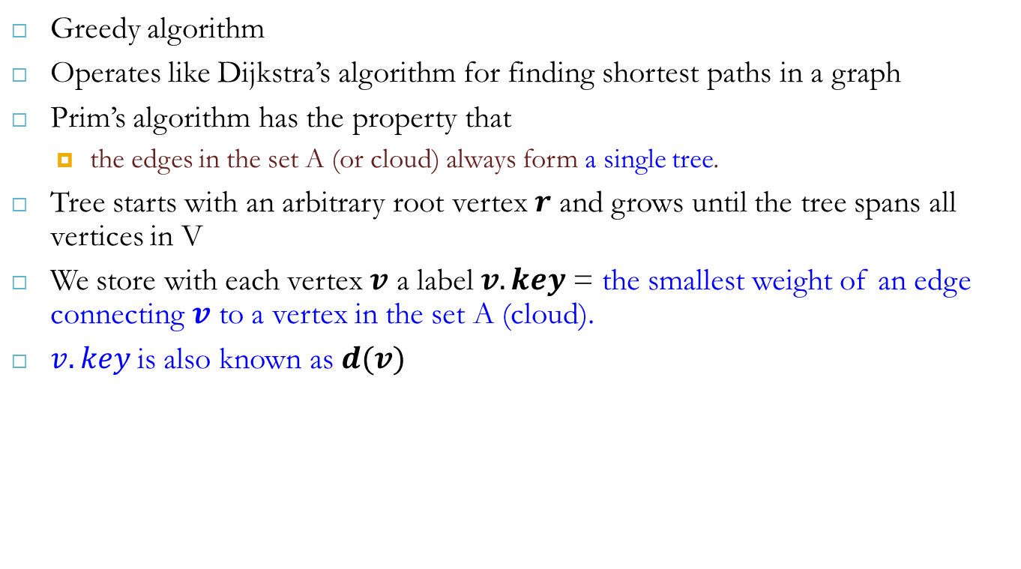
Prim’s Algorithm
Greedy algorithm
Operates like Dijkstra’s algorithm for finding shortest paths in a graph
Prim’s algorithm has the property that
the edges in the set A (or cloud) always form a single tree.
Tree starts with an arbitrary root vertex $r$ and grows until the tree spans all vertices in V
We store with each vertex $v$ a label $v.key$= the smallest weight of an edge connecting $v$ to a vertex in the set A (cloud).
$v.key$is also known as $d(v)$
At each step:
We add to set A a vertex $v$ outside the set with the smallest key label
We update the labels of the vertices adjacent to $v$

Slide 8
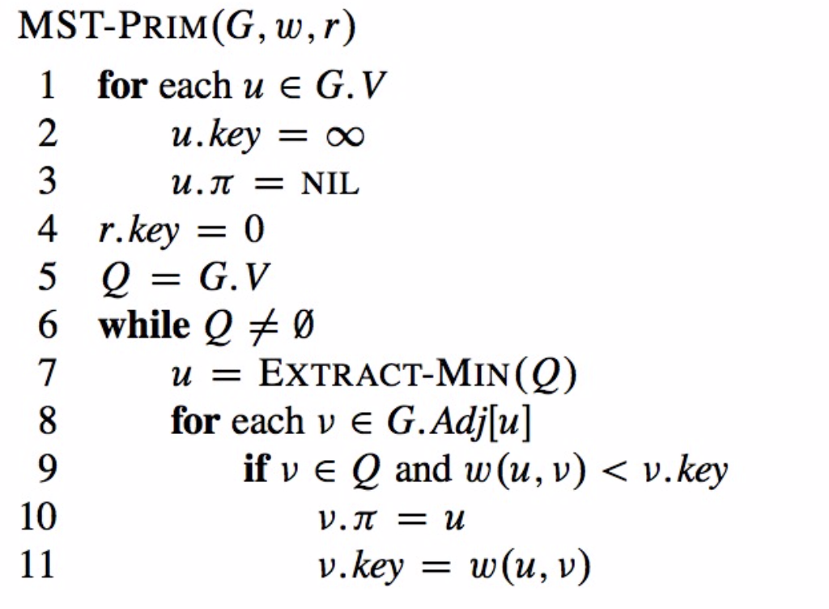
Prims Algorithm (cont.)

Slide 9
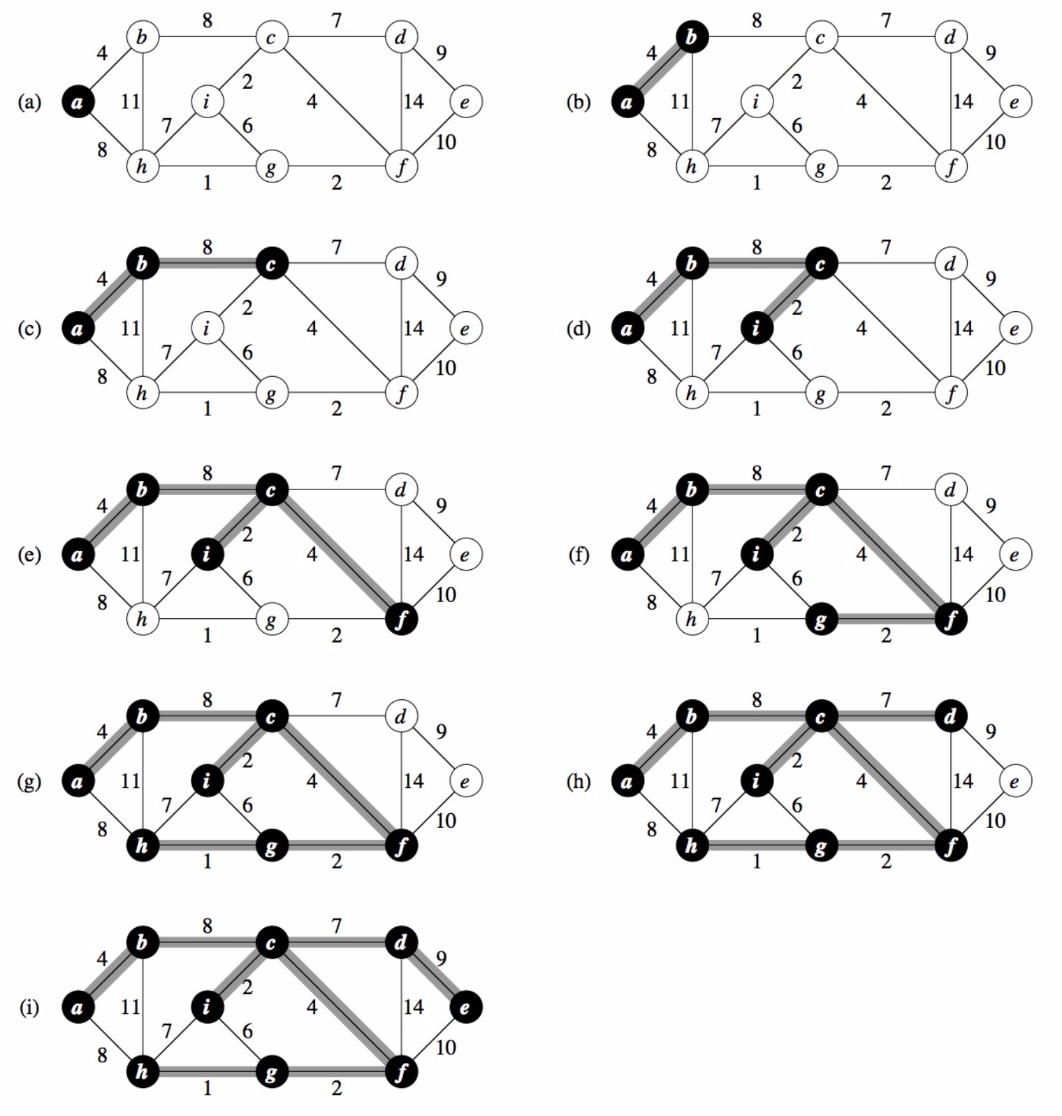
Prim’s Algorithm: Example 1

Slide 10
Prim’s Algorithm: Example 2
∞
7
2
7
D
2
7
D
B
4
B
4
8
9
∞
5
9
∞
2
5
F
2
5
F
C
8
C
8
8
3
8
3
E
E
A
7
7
A
7
7
0
0
7
7
2
7
D
7
D
B
4
2
B
4
5
9
∞
9
4
2
5
F
5
5
C
2
F
8
C
8
8
3
3
E
8
A
7
E
0
7
A
7
7
0

Slide 11
Prim’s Algorithm: Example 2 (cont.)
7
2
7
D
B
4
5
9
4
2
5
F
C
8
8
3
E
A
7
3
7
0
7
D
2
B
4
5
9
4
2
5
F
C
8
8
3
E
A
7
3
0

Slide 12
Prim’s Algorithm (Cormen, Chapter23, p 634-636)
How often is ExtractMin() called?
How often is DecreaseKey() called?

Slide 13
Prim’s Algorithm (Cormen, Chapter23, p 634-636)
How often is ExtractMin() called?
How often is DecreaseKey() called?
What will be the runtime?
A: Depends on queue; Binary heap: O(V lg V + E lg V)
O (E lg V)

Slide 14
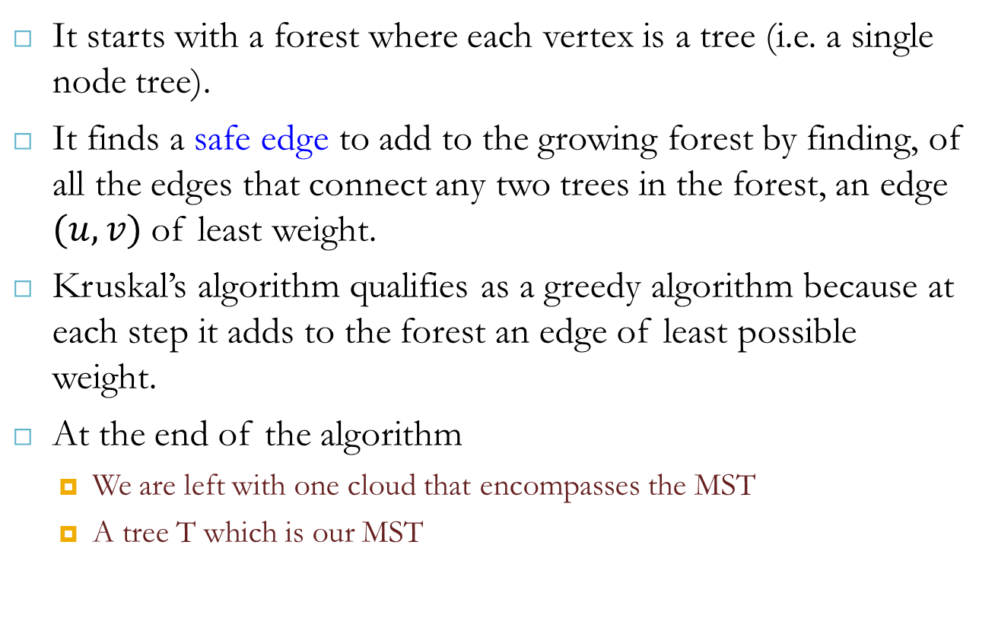
Kruskal’s Algorithm
It starts with a forest where each vertex is a tree (i.e. a single node tree).
It finds a safe edge to add to the growing forest by finding, of all the edges that connect any two trees in the forest, an edge $(u,v)$of least weight.
Kruskal’s algorithm qualifies as a greedy algorithm because at each step it adds to the forest an edge of least possible weight.
At the end of the algorithm
We are left with one cloud that encompasses the MST
A tree T which is our MST

Slide 15
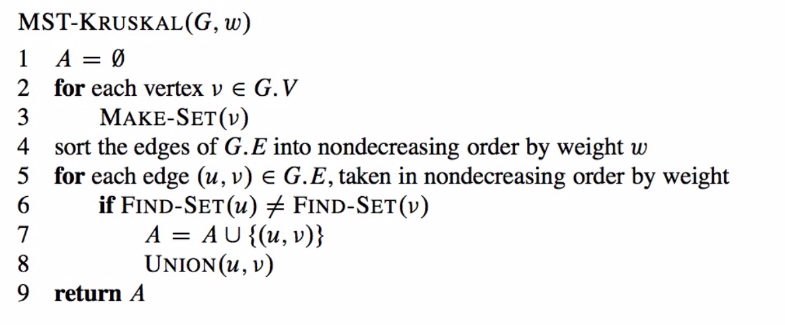
Kruskal’s Algorithm

Slide 16
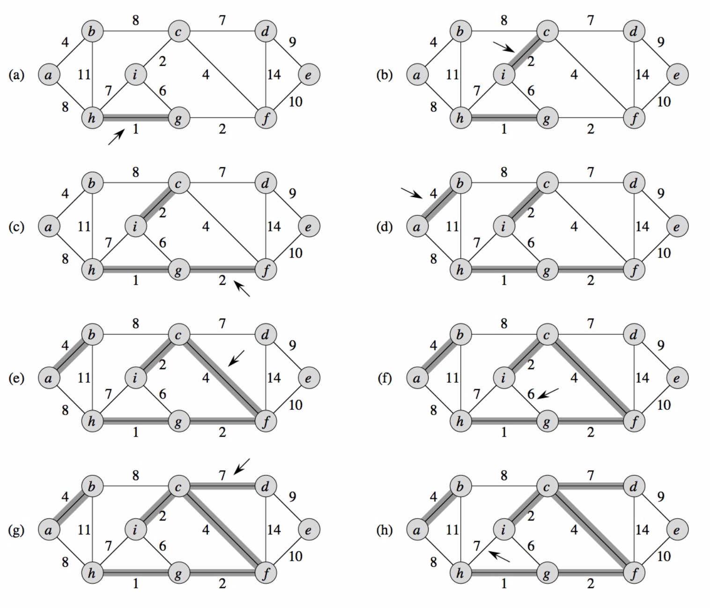
Kruskal’s Algorithm: Example 1

Slide 17
Kruskal Algorithm : Example 2
2704
867
BOS
849
PVD
ORD
187
740
144
1846
621
JFK
184
1258
802
SFO
BWI
1391
1464
337
1090
DFW
946
LAX
1235
1121
MIA
2342

Slide 18
Kruskal Algorithm : Example 2 (cont.)

Slide 19
Kruskal Algorithm : Example 2 (cont.)

Slide 20
Kruskal Algorithm : Example 2 (cont.)

Slide 21
Kruskal Algorithm : Example 2 (cont.)

Slide 22
Kruskal Algorithm : Example 2 (cont.)

Slide 23
Kruskal Algorithm : Example 2 (cont.)

Slide 24
Kruskal Algorithm : Example 2 (cont.)

Slide 25
Kruskal Algorithm : Example 2 (cont.)

Slide 26
Kruskal Algorithm : Example 2 (cont.)

Slide 27
Kruskal Algorithm : Example 2 (cont.)

Slide 28
Kruskal Algorithm : Example 2 (cont.)

Slide 29
Kruskal Algorithm : Example 2 (cont.)

Slide 30
Kruskal Algorithm : Example 2 (cont.)
2704
867
BOS
849
PVD
ORD
187
740
144
1846
621
JFK
184
1258
802
SFO
BWI
1391
1464
337
1090
DFW
946
LAX
1235
1121
MIA
2342

Slide 31
Correctness Of Kruskal’s Algorithm
Sketch of a proof that this algorithm produces an MST for T:
Assume algorithm is wrong: result is not an MST
Then algorithm adds a wrong edge at some point
If it adds a wrong edge, there must be a lower weight edge (cut and paste argument)
But algorithm chooses lowest weight edge at each step. Contradiction

Slide 32
Kruskal’s Algorithm (Cormen)
What will affect its runtime?
Sorting (you can also use a Priority Queue), Set data structure…

Slide 33
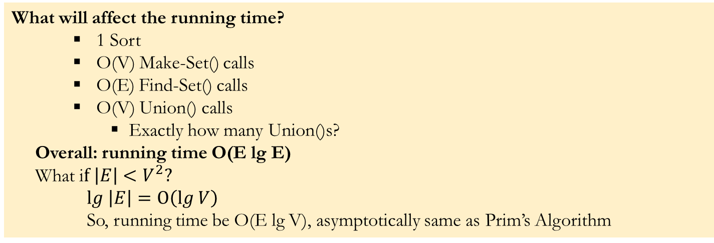
Kruskal’s Algorithm
What will affect the running time?
1 Sort
O(V) Make-Set() calls
O(E) Find-Set() calls
O(V) Union() calls
Exactly how many Union()s?
Overall: running time O(E lg E)
What i$f \left|E\right|<V^{2}?$
$lg \left|E\right|=O\left(lg V\right)$
So, running time be O(E lg V), asymptotically same as Prim’s Algorithm

Slide 34
Reference
Algorithm Design: Foundations, Analysis, and Internet Examples. Michael T. Goodrich and Roberto Tamassia. John Wiley & Sons.
Introduction to Algorithms. Thomas H. Cormen, Charles E. Leiserson, Ronald L. Rivest, Clifford Stein.
A few slides adapted from David Luebke.

Slide 35
Thank you!

